Slide 1
Using a Quantum genetic algorithm for cybersecurity budget allocation
AYUSH HARIHARAN

Slide 2
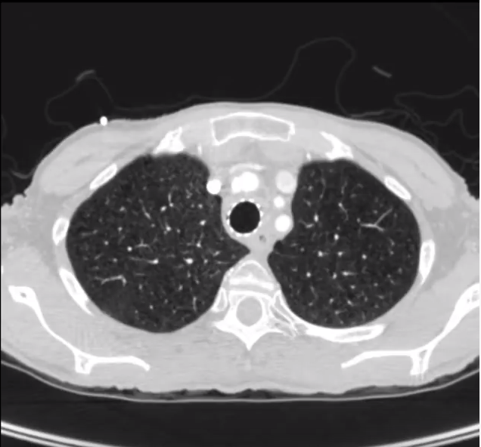
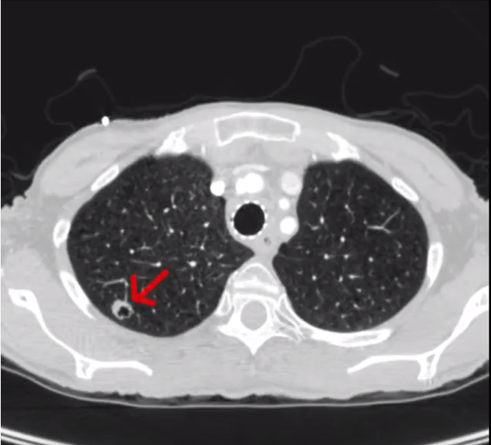
Medical hacking: a life or death scenario
https://www.everydayhealth.com/lung-cancer/treatment/lung-cancer-your-doctor-screening-you-best-treatment/
All Images from Mirsky et al.

Slide 3
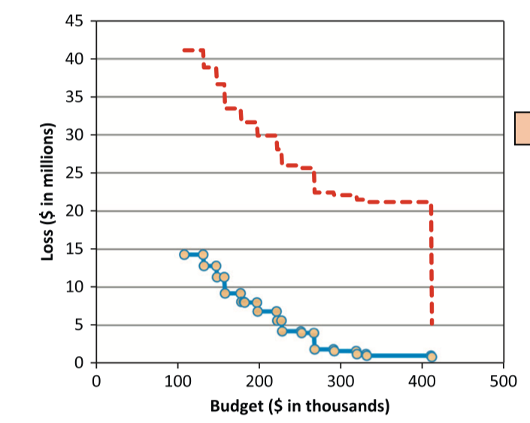
Linear Optimization Model
All images from Rakes et. al

Slide 4
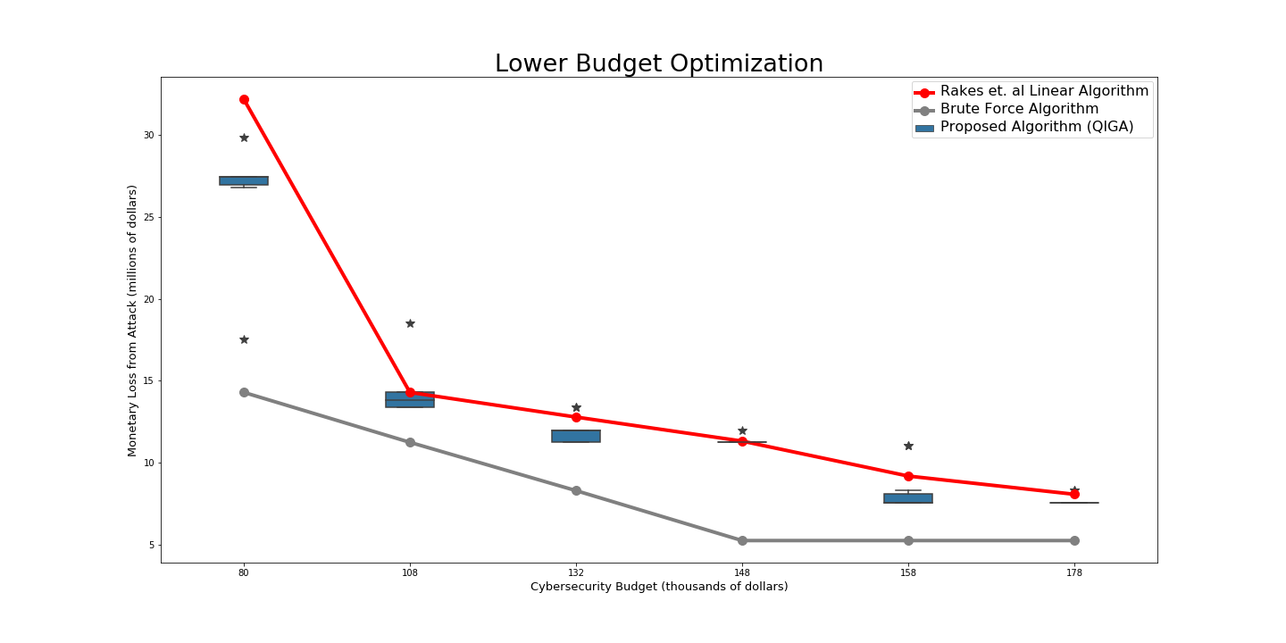
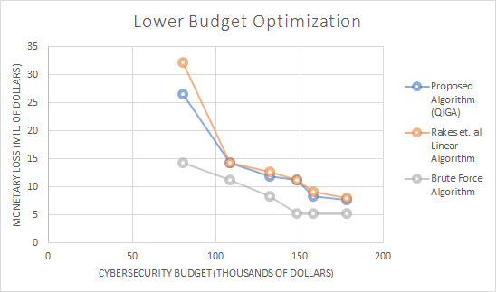
THE IMPACT OF QUANTUM SAVE
Budget | Proposed Algorithm (QIGA) | Rakes et. al Linear Algorithm | Brute Force Algorithm
80k | 26.57 M | 32.20 M | 14.29 M
108k | 14.26 M | 14.29 M | 11.24 M
132k | 11.95 M | 12.78 M | 8.294 M
148k | 11.31 M | 11.32 M | 5.244 M
158k | 8.340 M | 9.184 M | 5.244 M
178k | 7.714 M | 8.071 M | 5.244 M
Budget | Improvement (%)
80k | 17.48
108k | 0.24
132k | 6.53
148k | 0.05
158k | 9.19
178k | 4.42
All Values in Dollars Unless Stated

Slide 5
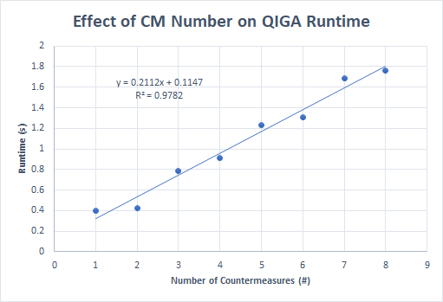
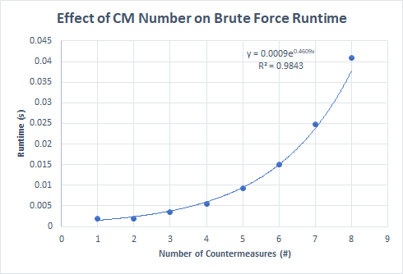
Time Complexity: quantum save VS brute force

Slide 6
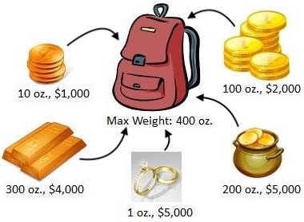
UNIQUENESS OF QUANTUM SAVE
https://www.cs.rpi.edu/academics/courses/spring12/proglang/pa3/pa3.html
https://www.theverge.com/2019/1/8/18171732/ibm-quantum-computer-20-qubit-q-system-one-ces-2019

Slide 7
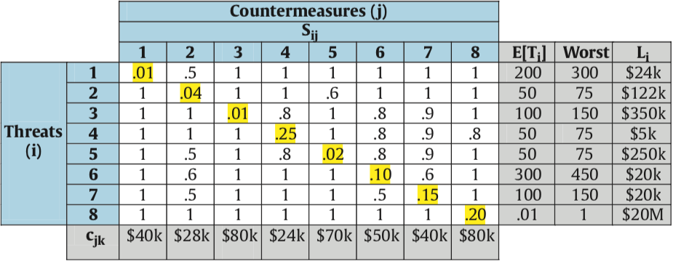
The Final dataset
Knapsack Problem
Saves $76k, Costs $40k
80k budget
Saves $103k, Costs $60k
Saves $55k, Costs $20k
All images from Rakes et. al

Slide 8
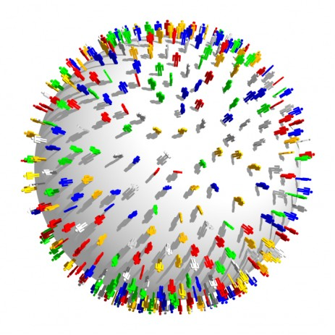
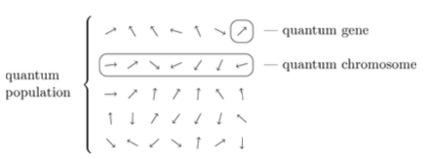
QUANTUM SAVE
Qubit as Counter Measure
https://owlcation.com/social-sciences/Human-Overpopulation-Its-Causes-Effects-and-Solutions
Row: CISO
Think Tank
https://www.thoughtco.com/charles-darwins-finches-1224472
https://www.smithsonianmag.com/science-nature/what-darwin-didnt-know-45637001/
https://www.nytimes.com/2019/10/21/science/quantum-computer-physics-qubits.html
https://www.youtube.com/watch?v=w56u2gv8XLs

Slide 9
The Power of the qubit
https://www.allaboutcircuits.com/news/aluminum-nitride-could-replace-diamond-in-qubit-creation/

Slide 10
QUANTUM SAVE CAN HELP SMALL COMPANIES AND HOSPITALS SAVE MILLIONS OF DOLLARS BY EFFECTIVELY ALLOCATING BUDGETS!

Slide 11
References
2018 Deloitte NAISCO Cybersecurity Study (2014) www.nascio.org/Portals/0/Publications/Documents /2018/2018DeloitteNASCIOCybersecurityStudyfinal.pdf
Birkett, A. (2015). How to Get Over Local Maximum? Everyone Hits It Eventually. CXL. Retrieved 16 October 2019, from https://conversionxl.com/blog/local-maximum/
Bossaerts, P., Murawski, C. (2016). How Humans Solve Complex Problems: The Case of the Knapsack Problem. Nature Partner Journals. doi: 10.1038/srep34851
Chapman, W. L., Rozenblit, J., & Bahill, A. T. (2001). System design is an NP‐complete problem. Systems Engineering, 4(3), 222-229.
Fielder, A., Panaousis, E., Malacaria, P., Hankin, C., & Smeraldi, F. (2016). Decision support approaches for cyber security investment. Decision Support Systems, 86, 13-23.
Forrester, R., (2017, Jan 20). The Quantum Measurement Problem: Collapse of the Wave Function Explained. Social Science Research Network. http://dx.doi.org/10.2139/ssrn.2901820
Fu, C., Liu, J., Wang, H., & Zhi J. (2013, Mar 9). The Improvement of Quantum Genetic Algorithm and Its Application on Function Optimization. Hindawi, 2013. dx.doi.org/10.1155/2013/730749
Garg A., Goyal S. (2017). Vector Sparse Representation of Color Image Using Quaternion Matrix Analysis Based on Genetic Algorithm. Imperial Journal of Interdisciplinary Research, 3(7).
IBM Research Editorial Staff. (2018). An Open High-Performance Simulator for Quantum Circuits. IBM Research Blog. Retrieved 5 June 2019, from https://www.ibm.com/blogs/research/2018/05/quantum-circuits/
Kucharski, J., Nowotniak, R. (2012). GPU-based tuning of Quantum-Inspired Genetic Algorithm for a Combinatorial Optimization Problem. Bulletin of the Polish Academy of Science, 3(7). doi: 10.2478/v10175-012-0043-4
Kucharski, J., Nowotniak, R. (2014, Sept). Higher-Order Quantum-Inspired Genetic Algorithms. IEEE. doi: 10.15439/2014F99

Slide 12
References (cont.)
Mia, M. A. H., Rahman, M. A., & Uddin, M. (2007). E-Banking: Evolution, Status and Prospect. The Cost and Management, 35(1).
Mirsky, Y., Mahler, T., Shelef, I., & Elovici, Y. (2019). CT-GAN: Malicious tampering of 3D medical imagery using deep learning. In 28th {USENIX} Security Symposium ({USENIX} Security 19) (pp. 461-478).
Montanaro, A. (2016). Quantum Algorithms: An Overview. Nature Partner Journals. doi: 10.1038/npjqi.2015.23
Neves, J., Miguel, R. (1999). Preventing Premature Convergence to Local Optima in Genetic Algorithms via Random Offspring Generation. Lecture Notes in Computer Science, 1611, 127-136. https://doi.org/10.1007/978-3-540-48765-4\_16
Pan, Xiaohui & Zhang, Tao. (2018). Comparison and Analysis of Algorithms for the 0/1 Knapsack Problem. Journal of Physics: Conference Series. 1069. 012024. 10.1088/1742-6596/1069/1/012024.
Rachwald, R. (2008). Is banking online safer than banking on the corner? Computer Fraud & Security, 2008(3), 11–12. doi:10.1016/s1361-3723(08)70045-9
Rakes, T. R., Deane, J. K., & Paul Rees, L. (2012). IT security planning under uncertainty for high-impact events. Omega, 40(1), 79–88. doi:10.1016/j.omega.2011.03.008
The Copenhagen and Many Worlds Interpretations of Quantum Mechanics. (2019). Afriedman.org. Retrieved 16 October 2019, from http://afriedman.org/AndysWebPage/BSJ/CopenhagenManyWorlds.html

Slide 13
Any questions?

Slide 14
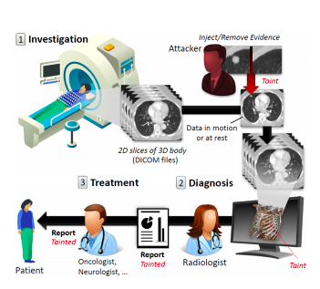
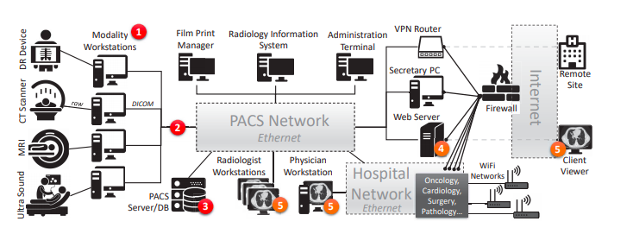
RESERVE – prominence of medical hacks
All Images from Mirsky et al.

Slide 15
Reserve – other types of hacks
Iranian Based Hackers (Iridium) hacked into Citrix Network 10 years ago
Recently, stole 6 terabytes of government data
Names, Social Security Numbers, and Financial Information Stolen
Hackers Stole Personal Information of 147.7 million Americans
Customer Names, Social Security Info, Addresses of Half the US Population
Russian Hackers Selling Access to US Government’s Internal Network
Opening Price is $60,000
https://krebsonsecurity.com/tag/miracle-systems-llc/
https://www.cnet.com/news/equifaxs-hack-one-year-later-a-look-back-at-how-it-happened-and-whats-changed/
https://www.sdxcentral.com/articles/news/citrix-internal-network-hacked-by-international-criminals/2019/03/
https://thehackernews.com/2017/09/equifax-credit-report-hack.html
Notes:
In recent years, the number of attacks on public corporations and government contractors has increased drastically.
Lets start in our own backyard. Miracle Systems in Arlington VA had confidential government data stolen and that data was sold on Russian Cybercrime Forums for 60,000 dollars.
Next, lets look at Citrix -- another government contractor. Recon spyware was put into Citrix systems by Iranian hackers over 10 years ago and nothing was done. Now, through two attacks, they stole 6 terrabytes of sensitive data.
Thats just on the government side. Sony, Target, Capital One, have all been targets of hackers.

Slide 16
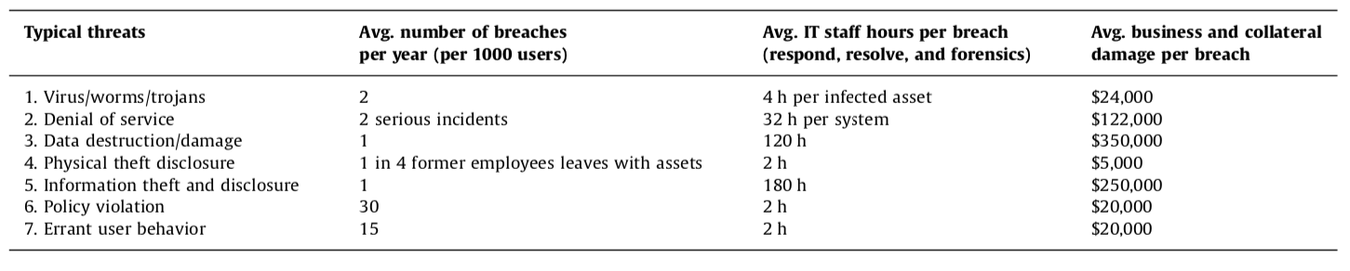
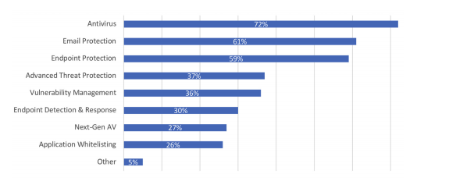
RESERVE – table abstraction removed
Rakes et al. (Citations)
https://www.knowbe4.com/hubfs/2018ThreatImpactandEndpointProtectionReport.pdf

Slide 17
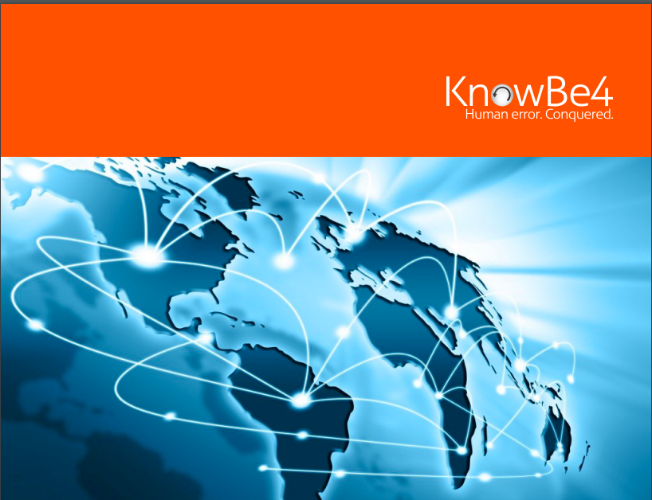
Reserve – full explanation of table
All images from Rakes et. al

Slide 18
Reserve – just the Table

Slide 19
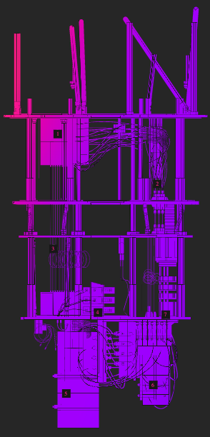
Reserve – how IBM quantum computer works

Slide 20
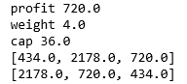
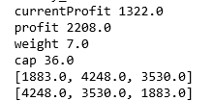
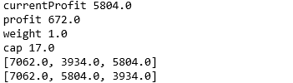
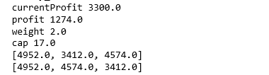
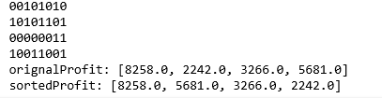
Reserve – choosing size of think-tank
3 Quantum Chromosomes, Old Knapsack Weight Cap
3 Quantum Chromosomes, New Knapsack Weight Cap
4 Quantum Chromosomes, New Knapsack Weight Cap

Slide 21
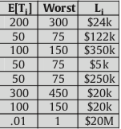
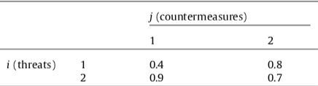
Reserve – rakes et al. linear model
1. P_{i} = (1 – Y₁e₁₁)(1 – Y₂e₁₂)
2. Loss = P_{i} * T_{i} * L_{i}
IT Security Planning Model
3. Constraint = c₁₁ Y₁ + c₁₂Y₂
4. Make it Linear

Slide 22
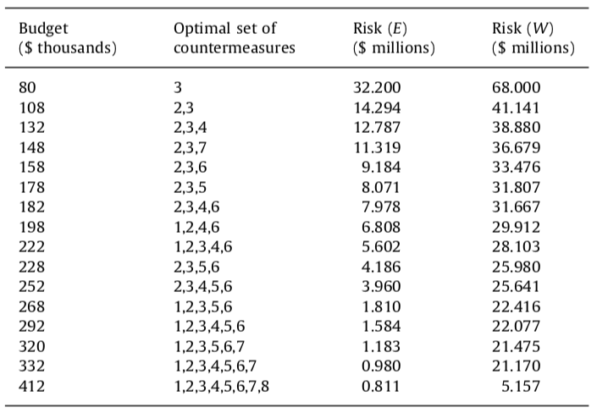
Reserve – Previous Research data

Slide 23
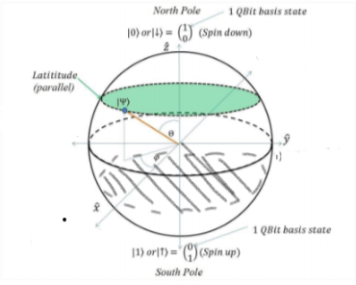
Reserve – phase 1 of quantum save
Countermeasure
Contractor

Slide 24
Reserve – phase 2 of quantum save
Countermeasures
Contractor with Best Defense

Slide 25
Reserve – disaster algorithm
https://conversionxl.com/blog/local-maximum/

Slide 26
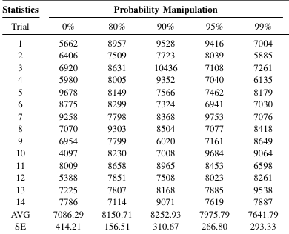
Reserve – tuning hyperparameters (amplitude)

Slide 27
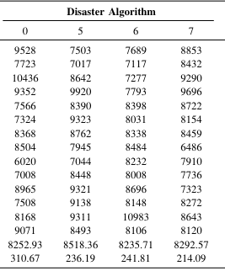
Reserve – tuning hyperparameters (disaster alg)

